Slide 1
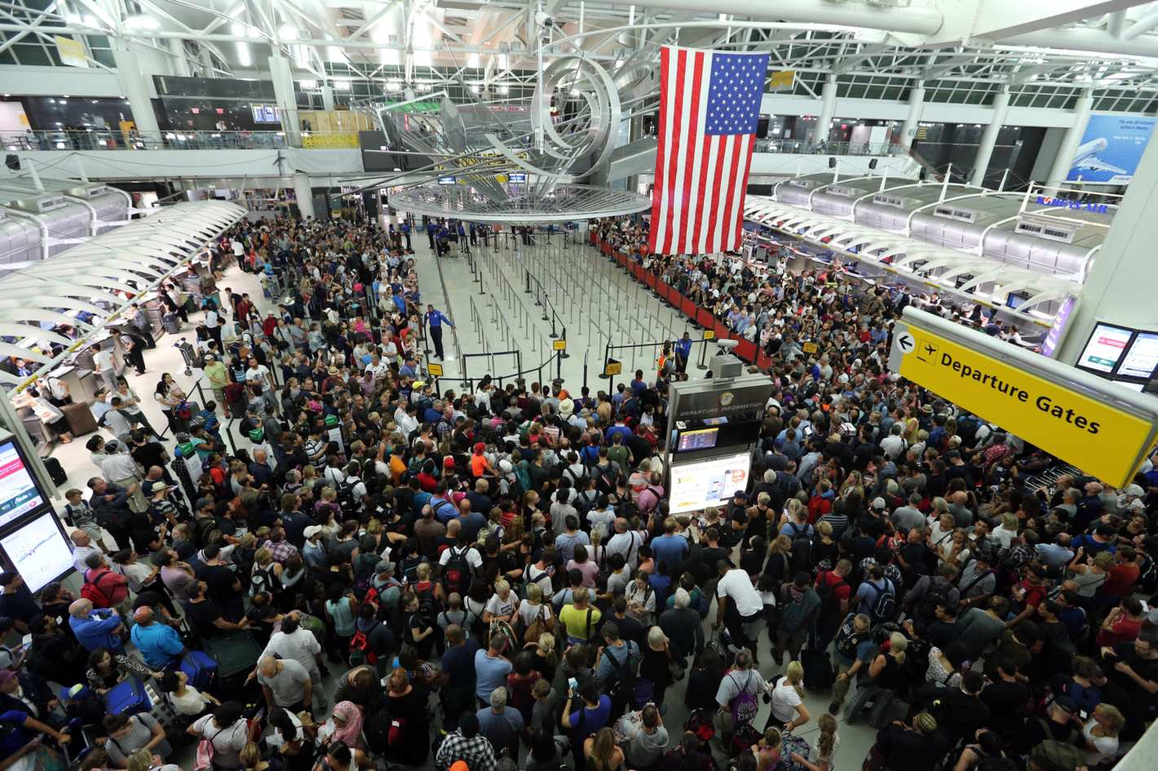
Tourists Visiting the United States of America
Swarup Sahoo
Chih-Hsiang Hsieh
Xintong Zhou

Slide 2
Outline
Data collection from NTTO website.
Data Preprocessing
ARMA Modelling
Stationary
Non-Stationary
ARMAV
12 Months Ahead Forecasts

Slide 3
Tourists Problem
Time period: Jan-2002 to Aug-2016
Monthly data
It seems like the number of tourists to the US has strong seasonal effect.
Didn’t use the data before 9/11
The event caused a big disturbance in the stationarity of the data
Really interesting long range pattern in data.
Tourism drops nearly every 7.5 year cycle.
Mid-Late 2001 – Terrorist Attack
Early 2009 – US Housing Market Crisis (Global economic crisis)
Late 2016 – Unpredictable Elections?
Mid 2024 – Something worse?

Slide 4
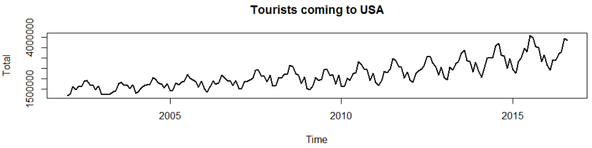
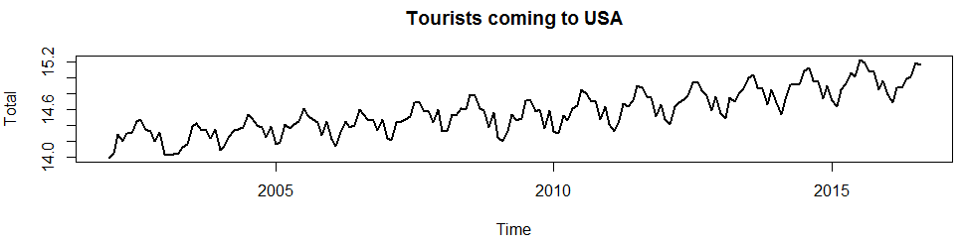
Data Processing
Heteroscedastic data:
After log transformation:
Time Period : Jan 2002 to Aug 2016
Seasonality: It seems that every year has the same pattern (period=12)

Slide 5
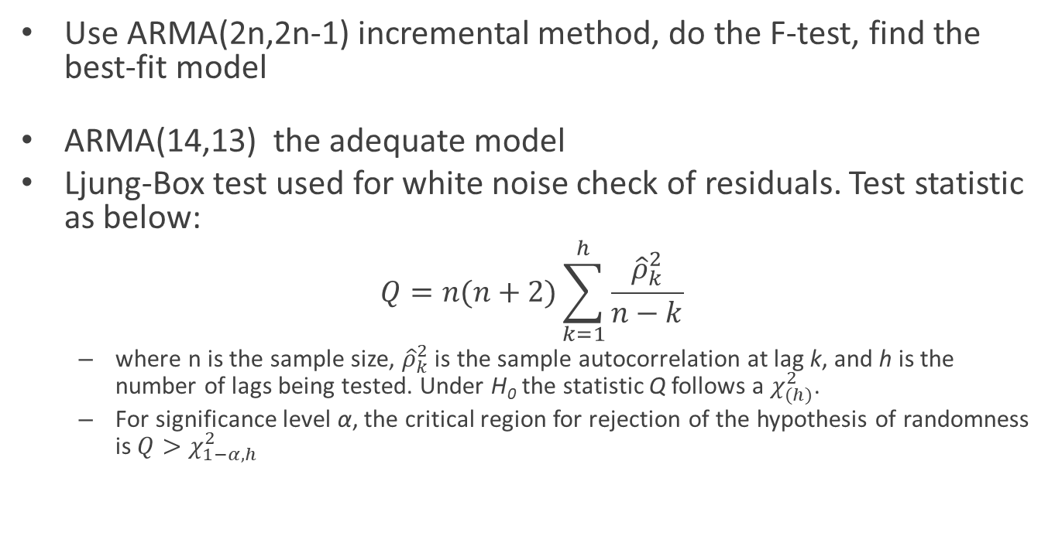
ARMA Modeling –Stationary
Use ARMA(2n,2n-1) incremental method, do the F-test, find the best-fit model
ARMA(14,13) the adequate model
Ljung-Box test used for white noise check of residuals. Test statistic as below:
$$Q=n(n+2)\sum_{k=1}^{h}{\frac{{\hat{ρ}}_{k}^{2}}{n−k}}$$
where n is the sample size, ${\hat{ρ}}_{k}^{2}$ is the sample autocorrelation at lag k, and h is the number of lags being tested. Under H₀ the statistic Q follows a $χ_{(h)}^{2}$.
For significance level α, the critical region for rejection of the hypothesis of randomness is $Q>χ_{1−α,h}^{2}$
Notes:
F-test stops at ARMA(24,23). However the at is not white. Then I continues

Slide 6
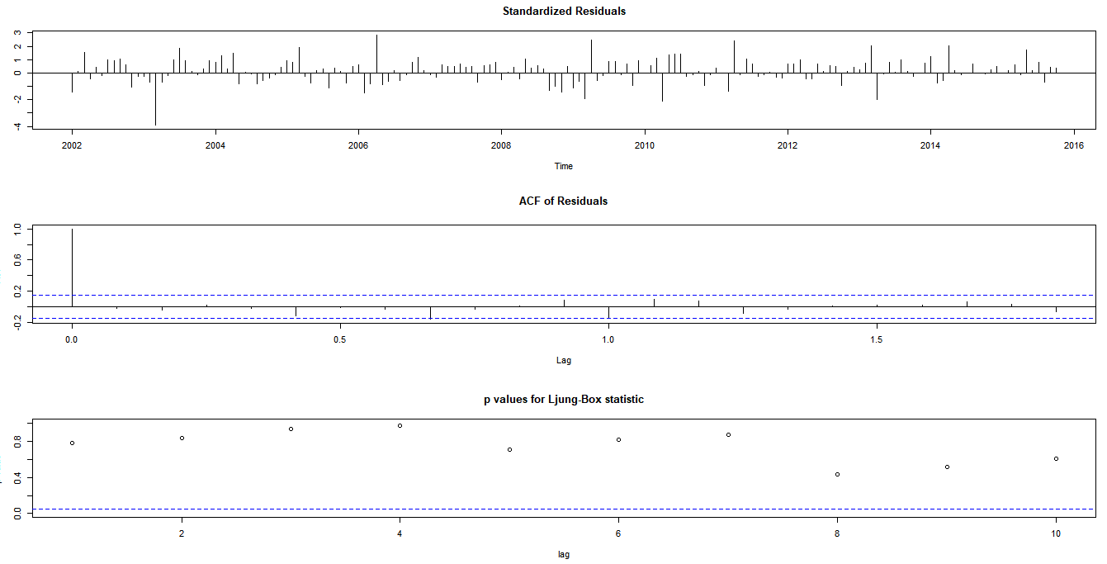
White noise check: (14,13) model
P-value for Ljung-Box > 0.05 ➔ fail to reject H₀ ➔ a_{t} is white noise

Slide 7
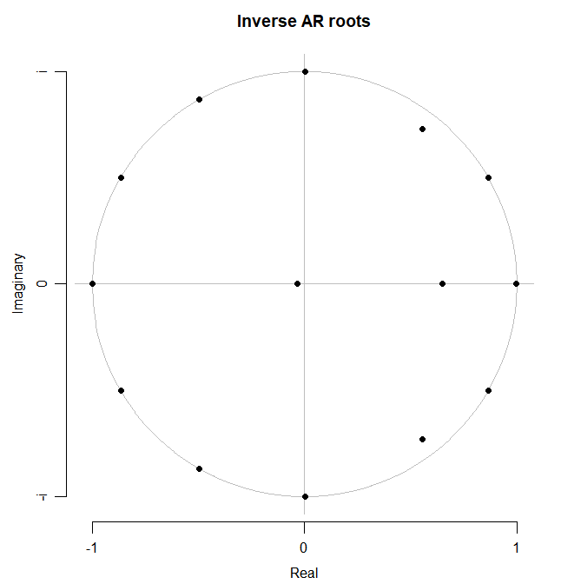
Roots:
Dying Roots
Seasonality
Trend
Root | Real | Imag | Absolute Values | Periodicity
λ1 | 0.865 | 0.501 | 1.000 | 12.0
λ2 | 0.865 | -0.501 | 1.000 | 12.0
λ3 | 0.005 | 1.000 | 1.000 | 4.0
λ4 | 0.005 | 1.000 | 1.000 | 4.0
λ5 | -0.494 | 0.869 | 1.000 | 3.0
λ6 | -0.494 | -0.869 | 1.000 | 3.0
λ7 | -0.865 | 0.502 | 1.000 | 2.4
λ8 | -0.865 | -0.502 | 1.000 | 2.4
λ9 | -0.035 | 0.000 | 0.0 | -
λ10 | 0.648 | 0.000 | 0.6 | -
λ11 | -0.999 | 0.000 | 0.999 | -
λ12 | 0.555 | 0.729 | 0.9 | -
λ13 | 0.555 | -0.729 | 0.9 | -
λ14 | 0.997 | 0.000 | 0.997 | -
Seasonal part

Slide 8
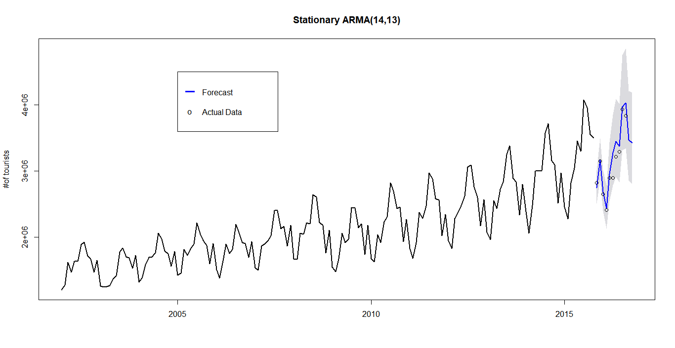
Prediction (12 steps ahead)
Compared with 10 actual data points

Slide 9
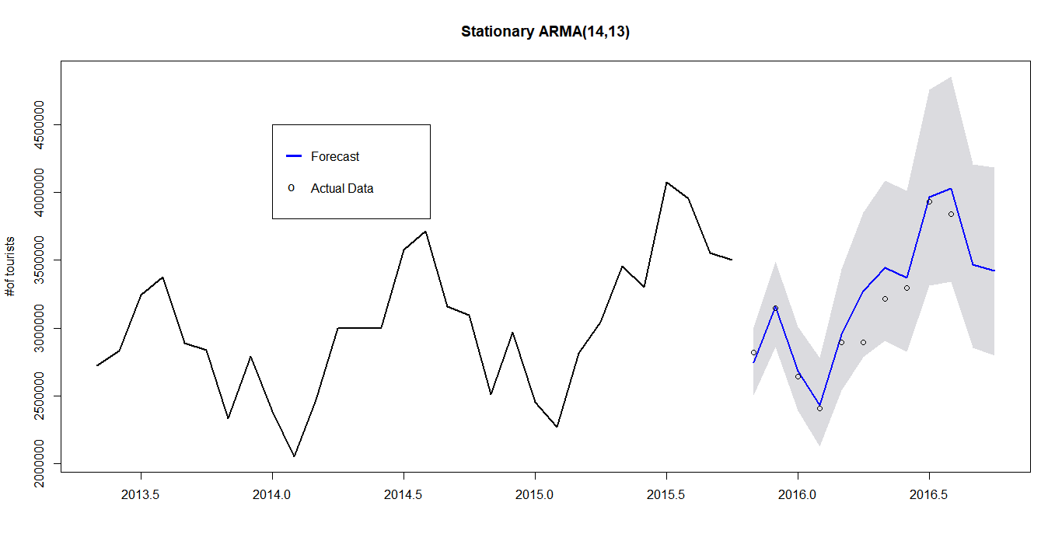
Prediction (12 steps ahead)-Zoom Plot
Compared with 10 actual data points

Slide 10
Parsimonious Model:
λ₁₄ is a real root (≈1)=> implies positive trend
λ_{1/2/3/4/5/6/7/8} show periodicity = 12 and their harmonics.
λ₁₁ is a real root (≈-1)=> implies zig-zag pattern seasonality
Parsimonious model: (1-B) (1+B)(1+1.729B+B²) (1+0.986B+B²)
(1-1.729B+B²) (1-0.009B+B²) ARMA(4,13)
trend
seasonal
seasonal

Slide 11
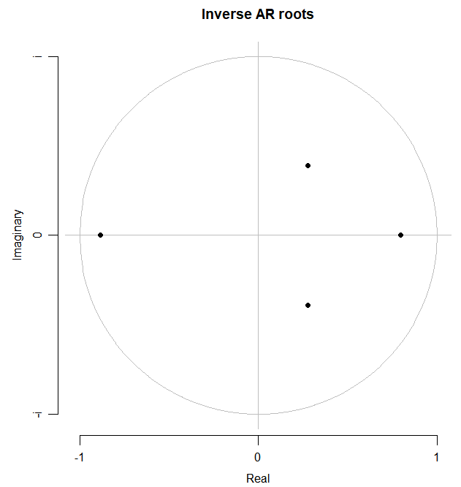
Parsimonious model AR roots:
Root | Real | Imag | Absolute Values | Periodicity
λ₁ | 0.276 | 0.391 | 0.48 | -
λ₂ | 0.276 | -0.391 | 0.48 | -
λ₃ | -0.883 | 0.000 | 0.88 | -
λ₄ | 0.796 | 0.000 | 0.80 | -
Notes:
Parsimonious Model does not show to be adequate so original model is being used.

Slide 12
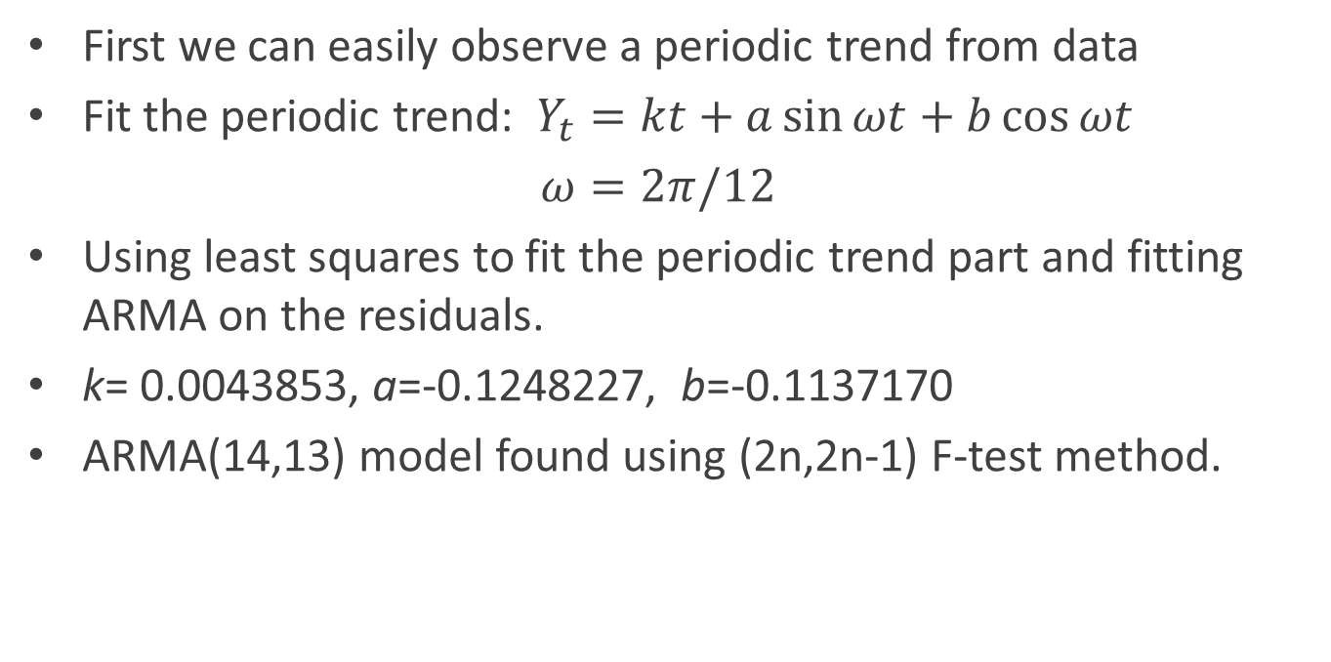
Non-stationary Time Series Model
First we can easily observe a periodic trend from data
Fit the periodic trend: $Y_{t}=kt+a\sin{ωt+b\cos{ωt}}$
$ω=2π/12$
Using least squares to fit the periodic trend part and fitting ARMA on the residuals.
k= 0.0043853, a=-0.1248227, b=-0.1137170
ARMA(14,13) model found using (2n,2n-1) F-test method.

Slide 13
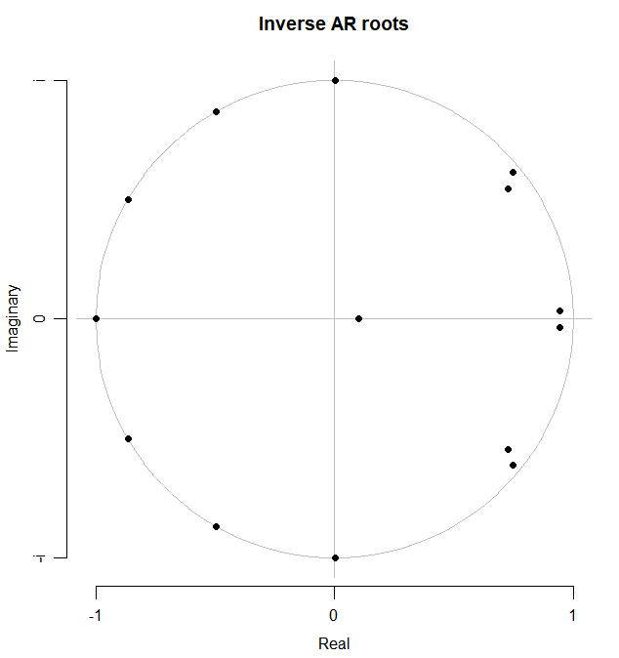
Non-Stationary AR(14) Roots:
Seasonality
Dying Roots
Notes:
Parsimonious Model does not show to be adequate so original model is being used.

Slide 14
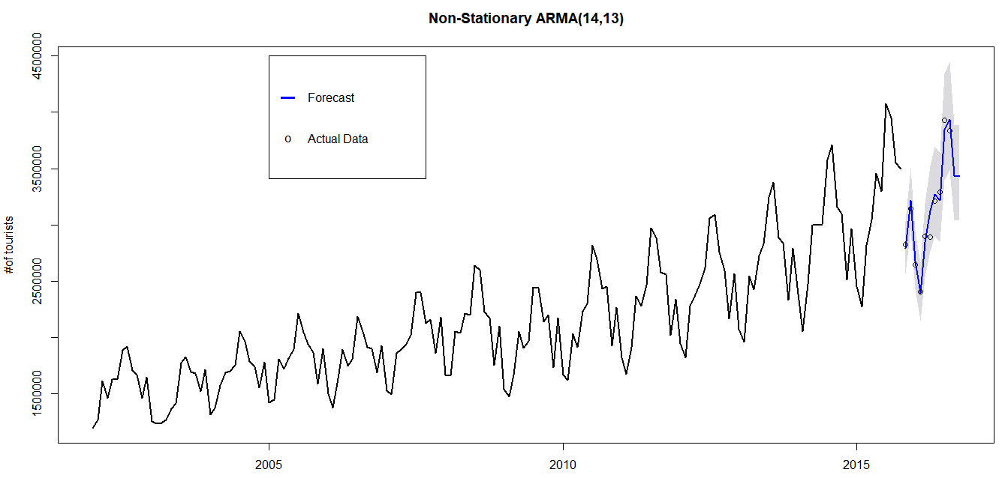
Prediction (12 steps ahead)

Slide 15
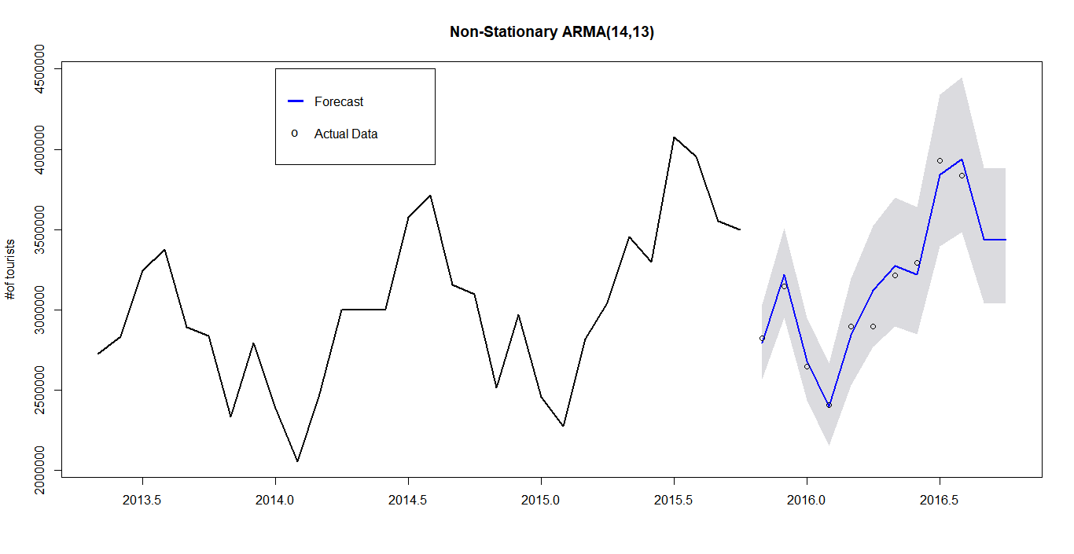
Prediction (12 steps ahead) – Zoom Plot

Slide 16
ARMAV modeling
Information of tourist from another country.
See how the output affects input.
Covariance matrix:
 | TOTAL | GERMANY | SOUTH KOREA | AUSTRALIA
TOTAL | 0.004477493 | 0.006089834 | 0.001548936 | 0.002940034
GERMANY | 0.006089834 | 0.012151337 | 0.002053682 | 0.003839761
SOUTH KOREA | 0.001548936 | 0.002053682 | 0.007620268 | 0.000681619
AUSTRALIA | 0.002940034 | 0.003839761 | 0.000681619 | 0.006104997

Slide 17
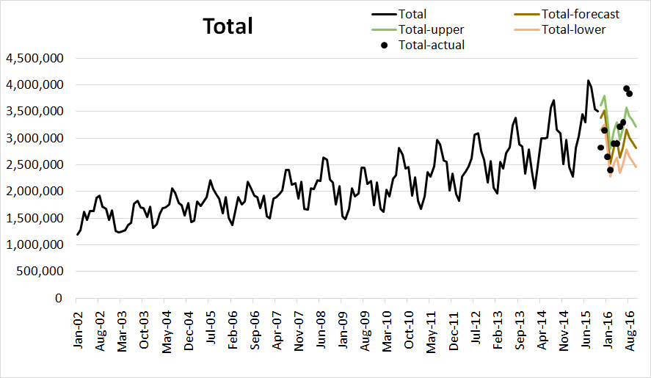
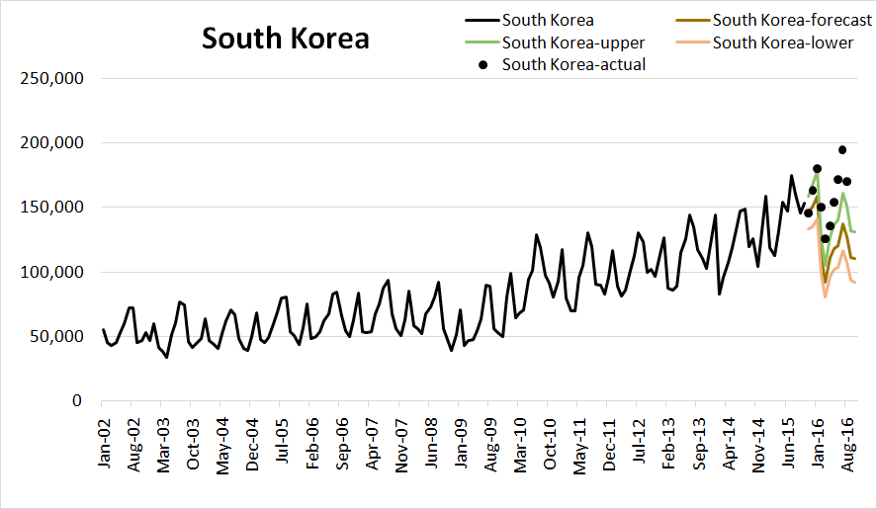
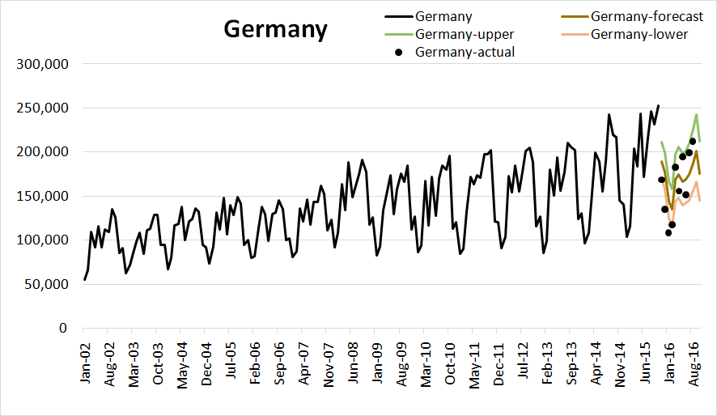
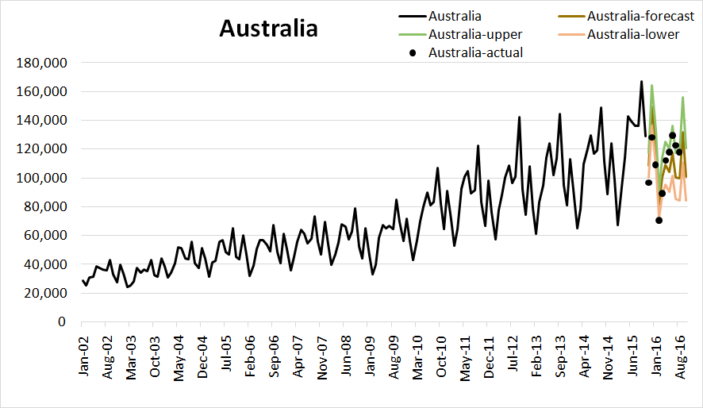
Prediction of ARMAV

Slide 18
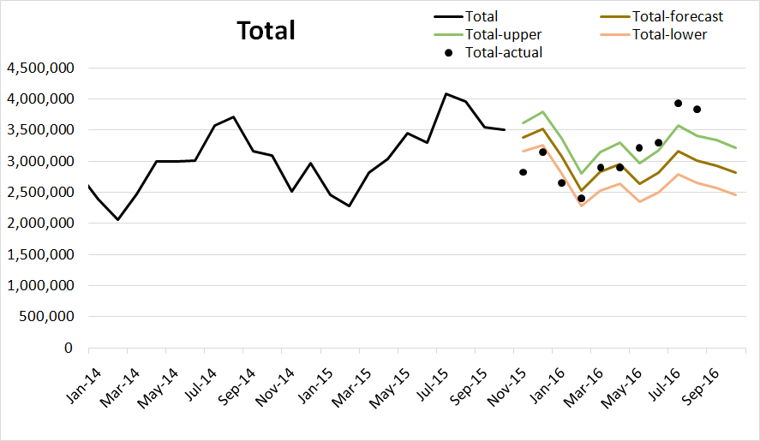
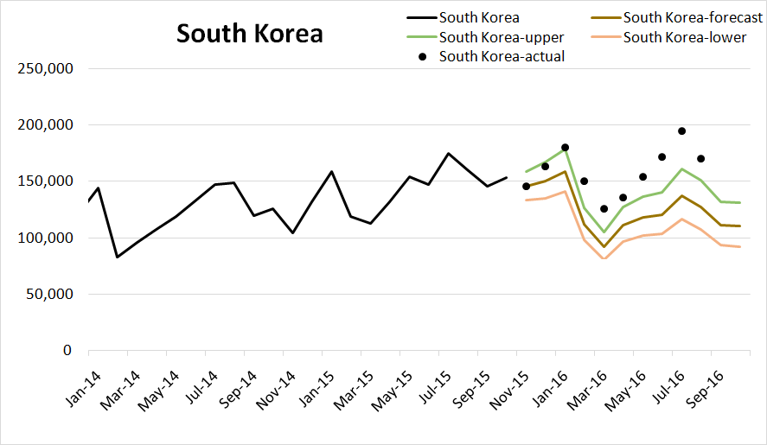
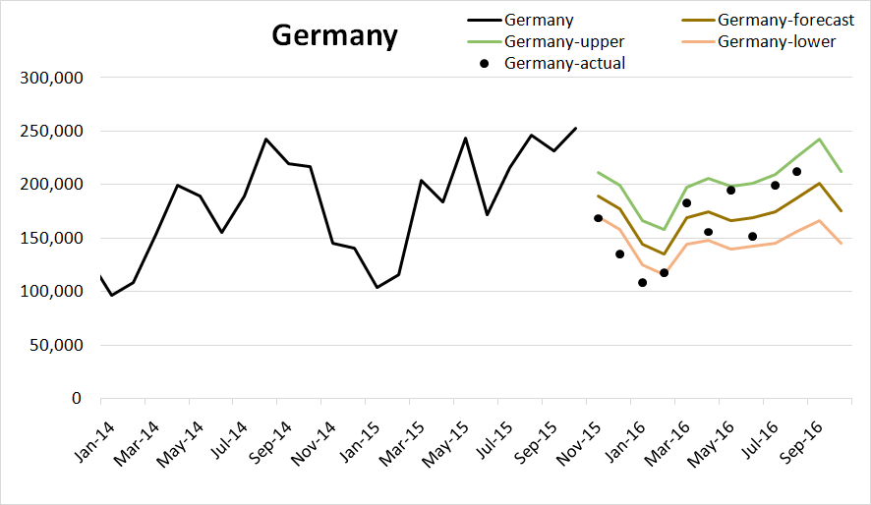
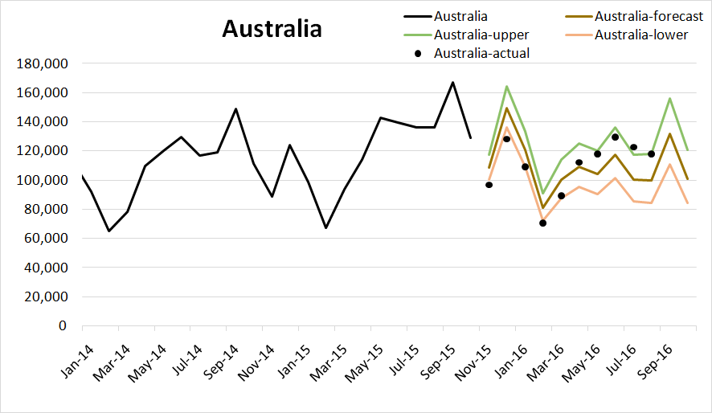
Prediction of ARMAV (Zoom in)

Slide 19
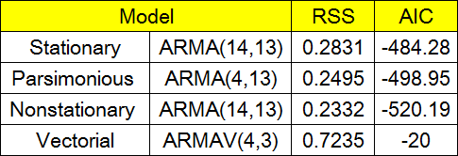
Conclusion
Non-Stationary modeling ARMA(14,13) gives the best prediction for the tourists arrivals. (the lowest RSS and AIC values)
The ARMA models grasped the long range (7.5 years) drop pattern we mentioned earlier (blew our minds).
The arrival number of tourists have the monthly periodicity.
Probably we will see another tourism drop in mid 2024 (please don’t take this point seriously).
Best fit

Slide 20

THANK YOU!

Slide 21
Appendix 1: Stationary ARMA(14,13) F test results
Parameters | ARMA order |  |  |  |  |  |  |  | Seasonal & trend parts
 | (2,1) | (4,3) | (6,5) | (8,7) | (10,9) | (12,11) | (14,13) | (16,15) | (4,13)
φ1 | 0.730 ± 0.558 | 0.912 ± 0.247 | -0.226 ± 0.257 | -0.019 ± 0.103 | -0.394 ± 0.549 | -0.448 ± 0.401 | 0.744 ± 0.731 | 0.717 ± 1.278 | 0.464 ± 0.524
φ2 | 0.175 ± 0.496 | 0.191 ± 0.398 | 0.427 ± 0.264 | 1.153 ± 0.097 | -0.008 ± 0.038 | 0.172 ± 0.367 | 0.186 ± 0.402 | -0.11 ± 2.320 | 0.521 ± 0.468
φ3 |  | -0.346 ± 0.314 | 0.394 ± 0.227 | 0.038 ± 0.205 | 0.981 ± 0.027 | 0.635 ± 0.330 | -0.005 ± 0.222 | 0.018 ± 1.490 | -0.408 ± 0.512
φ4 |  | 0.042 ± 0.175 | -0.002 ± 0.279 | -0.331 ± 0.190 | 0.394 ± 0.528 | 0.461 ± 0.389 | -0.201 ± 0.171 | -0.17 ± 0.923 | 0.161 ± 0.293
φ5 |  |  | 0.207 ± 0.249 | -0.038 ± 0.205 | 0.010 ± 0.011 | -0.177 ± 0.362 | -0.204 ± 0.115 | -0.094
φ6 |  |  | -0.379 ± 0.205 | -0.660 ± 0.190 | -0.985 ± 0.014 | -0.641 ± 0.328 | 0.006 ± 0.233 | 0.013 ± 0.132
φ7 |  |  |  | 0.016 ± 0.104 | -0.393 ± 0.546 | -0.457 ± 0.390 | 0.211 ± 0.172 | 0.108 ± 0.118
φ8 |  |  |  | 0.827 ± 0.095 | -0.010 ± 0.036 | 0.172 ± 0.362 | 0.192 ± 0.118 | 0.082
φ9 |  |  |  |  | 0.986 ± 0.027 | 0.643 ± 0.327 | 0.001 ± 0.226 | -0.00 ± 0.132
φ10 |  |  |  |  | 0.414 ± 0.531 | 0.482 ± 0.392 | -0.194 ± 0.181 | -0.08 ± 0.098
φ11 |  |  |  |  |  | -0.188 ± 0.369 | -0.238 ± 0.111 | -0.123
φ12 |  |  |  |  |  | 0.341 ± 0.335 | 1.016 ± 0.248 | 1.027 ± 0.143
φ13 |  |  |  |  |  |  | -0.506 ± 0.601 | -0.59 ± 1.390
φ14 |  |  |  |  |  |  | -0.018 ± 0.355 | 0.173 ± 2.312
φ15 |  |  |  |  |  |  |  | -0.02 ± 1.414
φ16 |  |  |  |  |  |  |  | 0.074 ± 0.908
θ1 | 0.001 ± 0.555 | -0.399 ± 0.207 | 1.070 ± 0.271 | 0.336 ± 0.157 | 0.758 ± 0.516 | 0.924 ± 0.332 | -0.297 ± 0.703 | -0.26 ± 1.208 | 0.921 ± 0.500
θ2 |  | 0.084 ± 0.238 | 0.610 ± 0.360 | -0.973 ± 0.158 | 0.790 ± 0.262 | 0.732 ± 0.427 | 0.149 ± 0.476 | 0.449 ± 1.709 | -0.232 ± 0.603
θ3 |  | 0.777 ± 0.214 | 0.673 ± 0.331 | 0.351 ± 0.217 | -0.089 ± 0.508 | 0.429 ± 0.462 | 0.200 ± 0.343 | 0.393 ± 1.068 | -0.529 ± 0.431
θ4 |  |  | 1.045 ± 0.216 | 0.978 ± 0.167 | 0.055 ± 0.105 | 0.351 ± 0.464 | 0.267 ± 0.393 | 0.393 ± 0.729 | -0.388 ± 0.593
θ5 |  |  | 0.283 ± 0.309 | -0.393 ± 0.223 | -0.028 ± 0.122 | 0.557 ± 0.321 | 0.276 ± 0.477 | 0.398 ± 0.601 | 0.142 ± 0.521
θ6 |  |  |  | -0.044 ± 0.156 | 0.860 ± 0.146 | 0.810 ± 0.191 | 0.144 ± 0.574 | 0.301 ± 0.706 | 0.471 ± 0.365
θ7 |  |  |  | 0.627 ± 0.134 | 0.638 ± 0.456 | 0.830 ± 0.351 | -0.011 ± 0.430 | 0.176 ± 0.606 | 0.219 ± 0.532
θ8 |  |  |  |  | 0.692 ± 0.253 | 0.625 ± 0.407 | 0.078 ± 0.460 | 0.263 ± 0.567 | -0.251 ± 0.426
θ9 |  |  |  |  | -0.197 ± 0.433 | 0.317 ± 0.410 | 0.098 ± 0.267 | 0.256 ± 0.427 | -0.481 ± 0.339
θ10 |  |  |  |  |  | 0.273 ± 0.413 | 0.273 ± 0.284 | 0.299 ± 0.519 | -0.273 ± 0.556
θ11 |  |  |  |  |  | 0.616 ± 0.309 | 0.340 ± 0.381 | 0.405 ± 0.551 | 0.332 ± 0.502
θ12 |  |  |  |  |  |  | -0.809 ± 0.537 | -0.67 ± 0.430 | -0.319 ± 0.338
θ13 |  |  |  |  |  |  | 0.298 ± 0.401 | 0.493 ± 1.589 | -0.598 ± 0.347
θ14 |  |  |  |  |  |  |  | -0.083 ± 1.407
θ15 |  |  |  |  |  |  |  | -0.119 ± 1.374
F |  | 23.17 | 14.18 | 59.03 | 25.65 | 5.80 | 3.02 | 0.52
AIC | -192.79 | -250.19 | -290.14 | -415.66 | -475.82 | -483.99 | -484.28 | -477.08 | -498.95

Slide 22
Appendix 2: Non-Stationary ARMA(14,13) F test results
Parameters | ARMA order
 | (2,1) | (4,3) | (6,5) | (8,7) | (10,9) | (12,11) | (14,13) | (16,15)
φ1 | 0.724 ± 0.234 | 0.371 ± 0.189 | 0.092 ± 0.144 | 0.311 ± 0.327 | -0.043 ± 0.168 | -0.070 ± 0.404 | 1.231 ± 0.129 | 1.18 ± 0.736
φ2 | 0.158 ± 0.164 | -0.537 ± 0.147 | 0.493 ± 0.136 | -0.030 ± 0.156 | -0.292 ± 0.125 | 0.550 ± 0.201 | 0.035 ± 0.248 | -0.364 ± 1.471
φ3 |  | 0.354 ± 0.189 | 0.46 ± 0.158 | -0.013 ± 0.137 | 0.866 ± 0.115 | 0.686 ± 0.362 | -0.23 ± 0.093 | 0.132 ± 1.066
φ4 |  | 0.464 ± 0.146 | 0.264 ± 0.171 | 0.124 ± 0.092 | 0.093 ± 0.187 | 0.208 ± 0.635 | -0.374 ± 0.095 | -0.098 ± 0.317
φ5 |  |  | 0.330 ± 0.119 | 0.237 ± 0.077 | 0.497 ± 0.182 | -0.421 ± 0.420 | -0.130 ± 0.084 | 0.145 ± 0.067
φ6 |  |  | -0.677 ± 0.116 | -0.733 ± 0.119 | -0.552 ± 0.181 | -0.606 ± 0.276 | 0.284 ± 0.065 | 0.186 ± 0.095
φ7 |  |  |  | 0.532 ± 0.222 | 0.248 ± 0.182 | -0.218 ± 0.624 | 0.430 ± 0.089 | 0.112 ± 0.134
φ8 |  |  |  | 0.121 ± 0.188 | -0.231 ± 0.116 | 0.272 ± 0.509 | 0.150 ± 0.077 | -0.056 ± 0.132
φ9 |  |  |  |  | 0.684 ± 0.125 | 0.344 ± 0.188 | -0.257 ± 0.051 | -0.181 ± 0.131
φ10 |  |  |  |  | -0.273 ± 0.161 | -0.104 ± 0.412 | -0.426 ± 0.085 | -0.220 ± 0.134
φ11 |  |  |  |  |  | -0.660 ± 0.323 | -0.238 ± 0.085 | -0.191 ± 0.165
φ12 |  |  |  |  |  | 0.328 ± 0.196 | 1.245 ± 0.052 | 0.994 ± 0.162
φ13 |  |  |  |  |  |  | -0.813 ± 0.239 | -1.133 ± 0.839
φ14 |  |  |  |  |  |  | 0.070 ± 0.188 | 0.356 ± 1.435
φ15 |  |  |  |  |  |  |  | -0.088 ± 1.018
φ16 |  |  |  |  |  |  |  | 0.173 ± 0.305
θ1 | -0.716 ± 0.192 | -0.449 ± 0.178 | 0.071 ± 0.212 | -0.239 ± 0.308 | 0.344 ± 0.060 | 0.449 ± 0.660 | -0.950 ± 0.158 | -0.890 ± 0.743
θ2 |  | 1.025 ± 0.053 | -0.470 ± 0.148 | 0.434 ± 0.134 | 0.803 ± 0.115 | -0.034 ± 0.426 | 0.117 ± 0.134 | 0.509 ± 1.274
θ3 |  | -0.383 ± 0.177 | -0.002 ± 0.202 | 0.467 ± 0.254 | -0.169 ± 0.112 | -0.270 ± 0.550 | 0.207 ± 0.112 | 0.034 ± 0.861
θ4 |  |  | 0.127 ± 0.182 | 0.107 ± 0.262 | 0.37 | -0.129 ± 1.282 | 0.226 | -0.005 ± 0.329
θ5 |  |  | -0.725 ± 0.113 | -0.042 ± 0.232 | -0.371 | 0.120 ± 1.035 | 0.083 | -0.193 ± 0.212
θ6 |  |  |  | 0.742 ± 0.152 | 0.167 ± 0.098 | 0.142 ± 0.187 | -0.224 ± 0.089 | -0.309 ± 0.202
θ7 |  |  |  | -0.640 ± 0.312 | -0.801 ± 0.014 | -0.124 ± 1.179 | -0.304 ± 0.095 | -0.319 ± 0.342
θ8 |  |  |  |  | -0.3475 | -0.232 ± 1.183 | -0.126 ± 0.105 | -0.150 ± 0.294
θ9 |  |  |  |  | -0.9965 | -0.045 ± 0.304 | 0.062 | -0.033 ± 0.345
θ10 |  |  |  |  |  | 0.462 ± 0.644 | 0.200 | 0.134 ± 0.206
θ11 |  |  |  |  |  | 0.966 ± 0.735 | 0.183 ± 0.047 | 0.331 ± 0.223
θ12 |  |  |  |  |  |  | -1.152 ± 0.145 | -0.788 ± 0.255
θ13 |  |  |  |  |  |  | 0.679 ± 0.181 | 1.092 ± 0.780
θ14 |  |  |  |  |  |  |  | -0.149 ± 1.237
θ15 |  |  |  |  |  |  |  | 0.048 ± 0.917
F |  | 31.00 | 11.00 | 15.75 | 16.97 | 5.07 | 3.74 | 0.38
AIC | -333.44 | -408.84 | -437.19 | -471.11 | -510.97 | -519.76 | -520.19 | 513.64

Slide 23
Appendix 3: φ coefficient matrix table of ARMAV model
 | φ1 |  |  |  | φ2 |  |  |  | φ3 |  |  |  | φ4
 | Tot | Ger | SK | Aus | Tot | Ger | SK | Aus | Tot | Ger | SK | Aus | Tot | Ger | SK | Aus
Tot | 1.06 | -0.45 | -0.2 | 0.42 | -0.19 | 0.36 | 0.19 | -0.19 | -0.38 | -0.23 | 0.07 | 0.62 | 0.63 | -0.32 | -0.20 | -0.45
Ger | 1.28 | -0.01 | -0.88 | 0.14 | 0.21 | 0.18 | 0.82 | 0.14 | -0.71 | -0.51 | -0.31 | 0.47 | 0.36 | -0.36 | -0.28 | -0.04
SK | 1.13 | -0.66 | 0.67 | 0.55 | -1.27 | 0.54 | -0.29 | -0.29 | 0.32 | -0.09 | -0.17 | 0.62 | -0.06 | -0.32 | 0.22 | -0.22
Aus | 0.30 | 0.30 | 0.19 | 0.28 | 0.16 | 0.11 | -0.27 | -0.32 | -0.13 | -0.46 | -0.53 | 1.35 | -0.70 | -0.07 | 0.52 | -0.01

Slide 24
Appendix 4: θ coefficient matrix table of ARMAV model
 | θ1 |  |  |  | θ2 |  |  |  | θ3
 | Tot | Ger | SK | Aus | Tot | Ger | SK | Aus | Tot | Ger | SK | Aus
Tot | 0.86 | -0.36 | -0.45 | 0.09 | -0.48 | 0.21 | -0.03 | 0.08 | -0.34 | -0.21 | 0.04 | 0.38
Ger | 1.32 | -0.10 | -1.05 | -0.19 | 0.17 | -0.35 | 0.41 | 0.20 | -0.86 | -0.23 | 0.14 | 0.56
SK | 1.51 | -0.76 | 0.00 | 0.21 | -1.01 | 0.39 | -0.19 | 0.14 | -0.12 | -0.12 | -0.16 | 0.32
Aus | 0.61 | 0.11 | 0.06 | -0.37 | -0.31 | 0.15 | 0.06 | -0.05 | 0.00 | -0.19 | -0.64 | 0.70

